Slide 1


PROJECT: V1.1
INFRASTRUCTURE AS CODE
Jamal Tadrous

Slide 2

TOPICS COVERED
TOPIC 1:
WHAT IS V1_0 AND WHAT IS EXCPECTED OF V1.1?
TOPIC 2:
WHAT_HOW_WHY
WHAT WAS MY APPROACH?
AGENDA
TOPIC 3:
WHAT DO I HAVE?
DIAGRAMS
CODE
DEMO TIME
TOPIC 4:
LEARNINGS & CONCLUSION

Slide 3
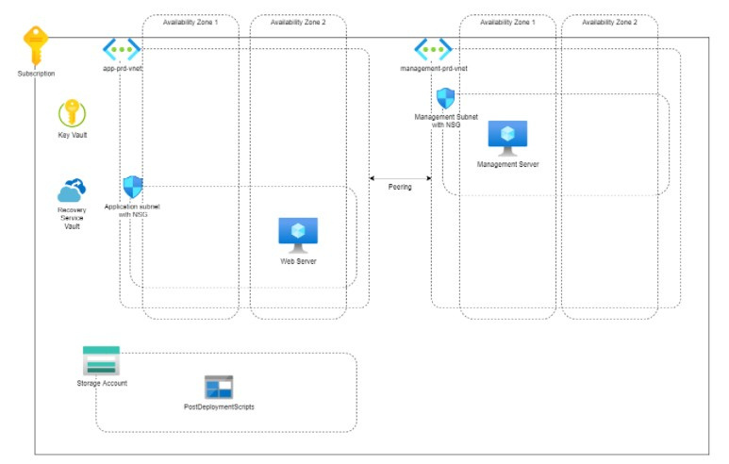

TOPIC 1:
WHAT IS V1.0?
Creation of infrastructure
Automation
Templates

Slide 4
TOPIC 1:
V1.0 SCOPE

Slide 5
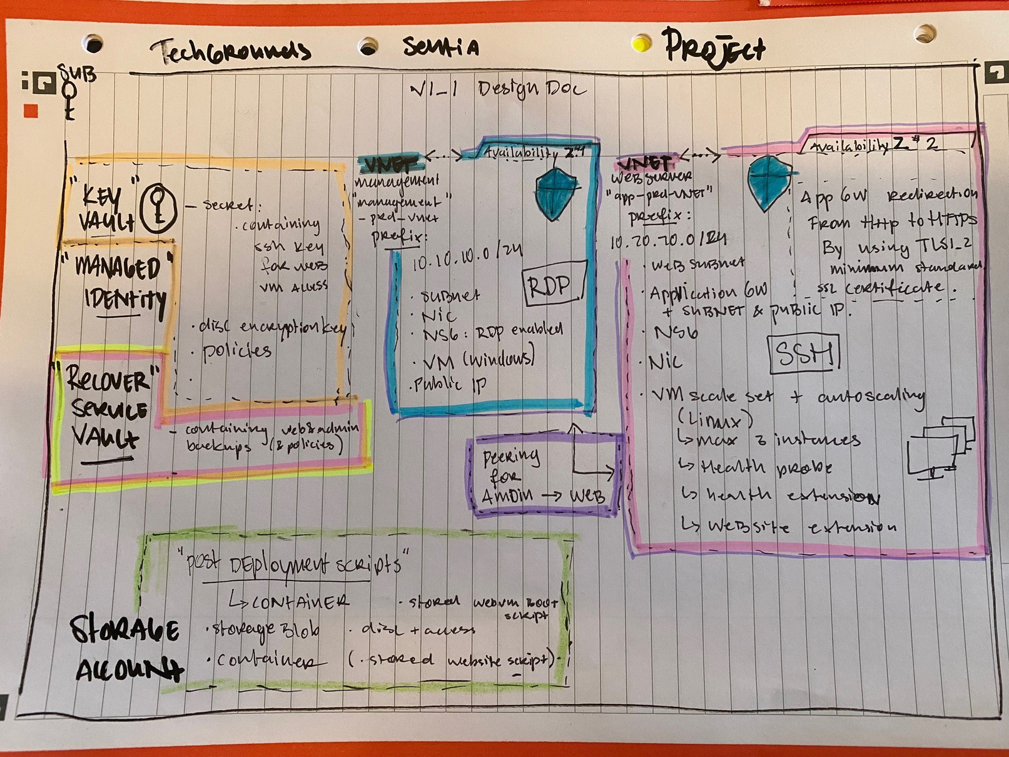
TOPIC 1:
V1.1 SCOPE // DESIGN DIAGRAM
1:

Slide 6
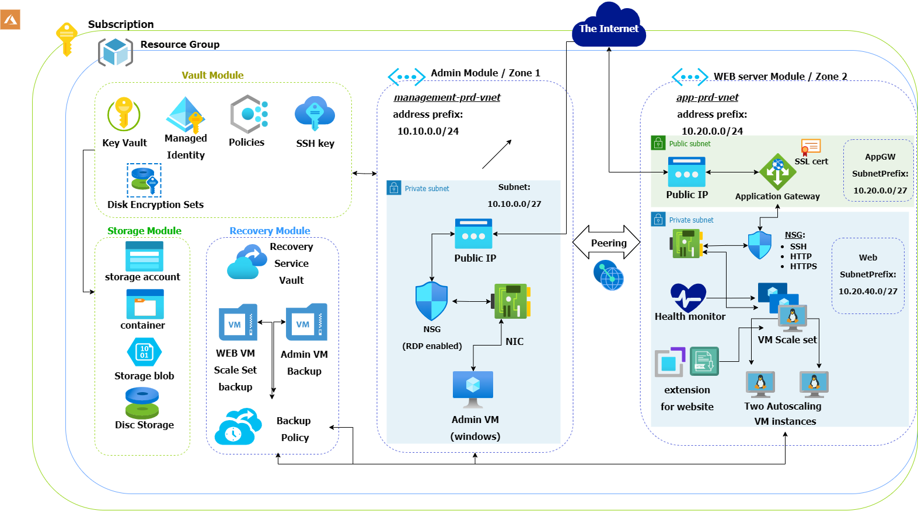
TOPIC 1:
V1.1 SCOPE // DESIGN DIAGRAM
2:

Slide 7

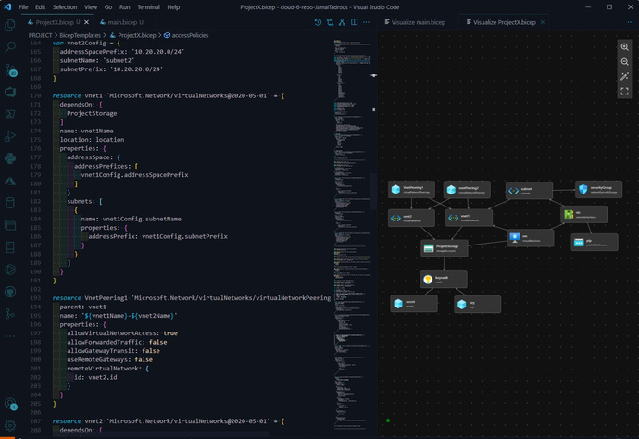
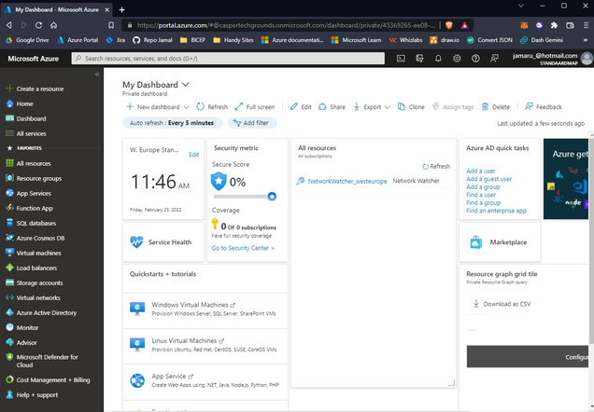
TOPIC 2:
WHAT_HOW_WHY
What
How
Goal
Creating Infrastructure
through code
Azure Bicep
Code Editor
Deployable Infrastructue

Slide 8
TOPIC 2:
WHAT WAS MY APPROACH?
What is Bicep?
How do i write the code?
How do i make the template?
How do i deploy the template?
declarative coding

Slide 9
TOPIC 3:
WHAT DO I HAVE?
LAYOUT MAIN.BICEP FILE
DIAGRAM V1_0
DIAGRAM V1_1
INSIGHTS OF THE MODULES

Slide 10
TOPIC 3:
/Main.bicep
containing:
RESOURCEGROUP
STORAGE ACCOUNT
ADMINSERVER
WEBSERVER
PEERING
KEYVAULT
RECOVERY SERVICE VAULT
MODULES

Slide 11
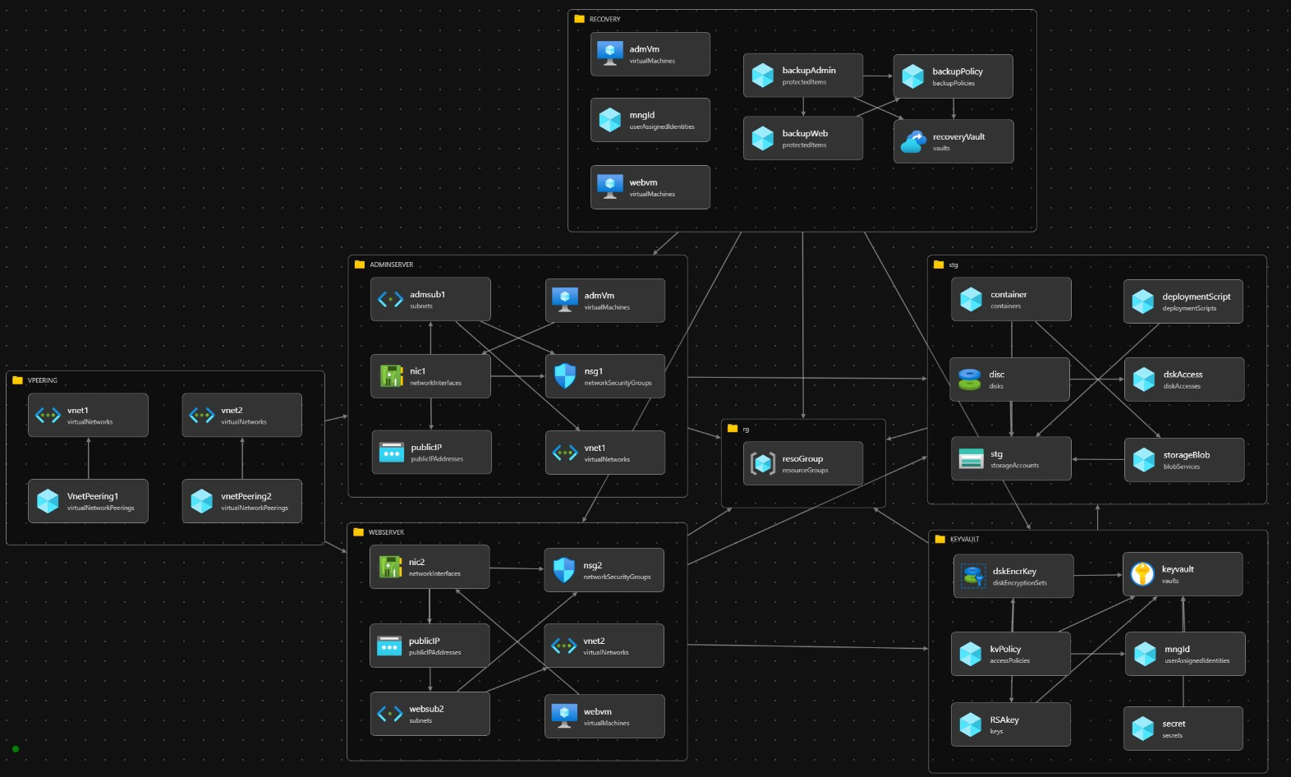
DIAGRAM V1_0
TOPIC 3:

Slide 12
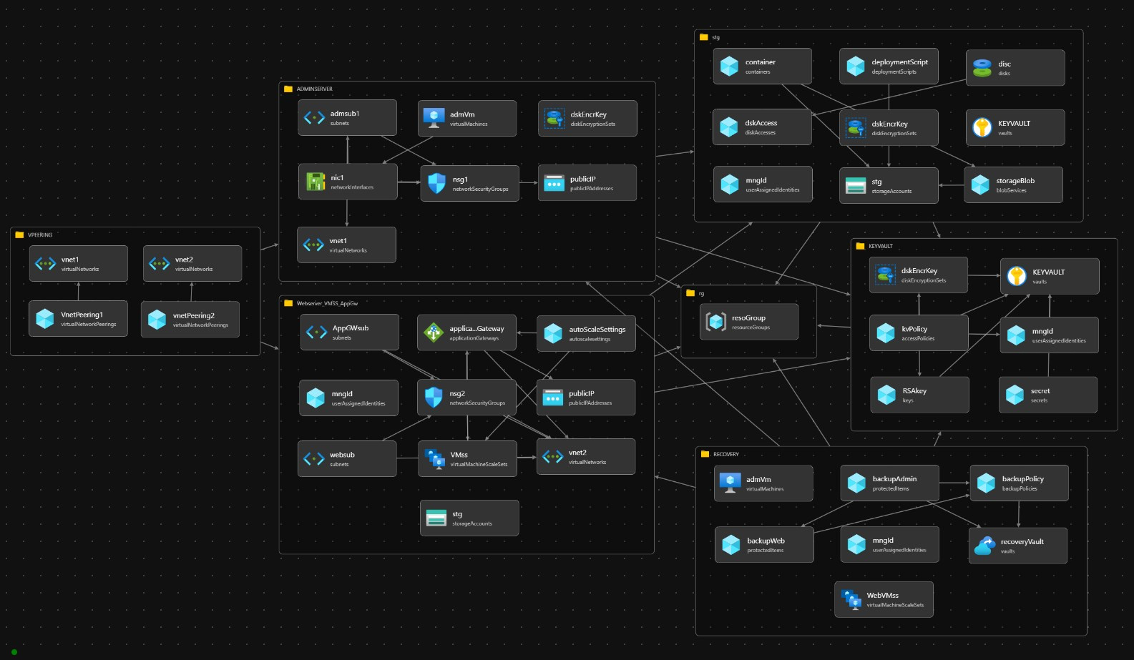
DIAGRAM V1_1
TOPIC 3:

Slide 13
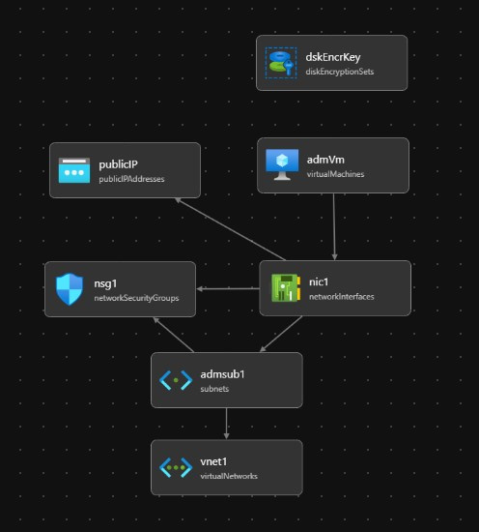
TOPIC 3:
ADMIN
SERVER
MODULE

Slide 14
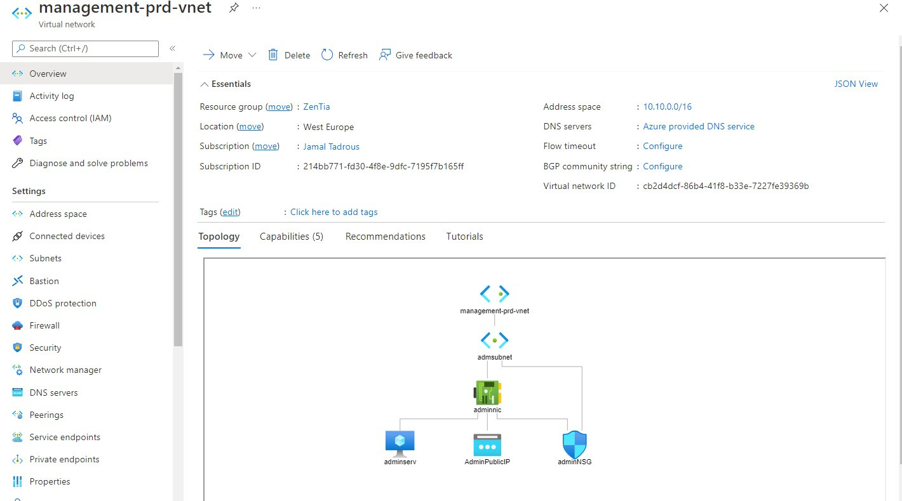
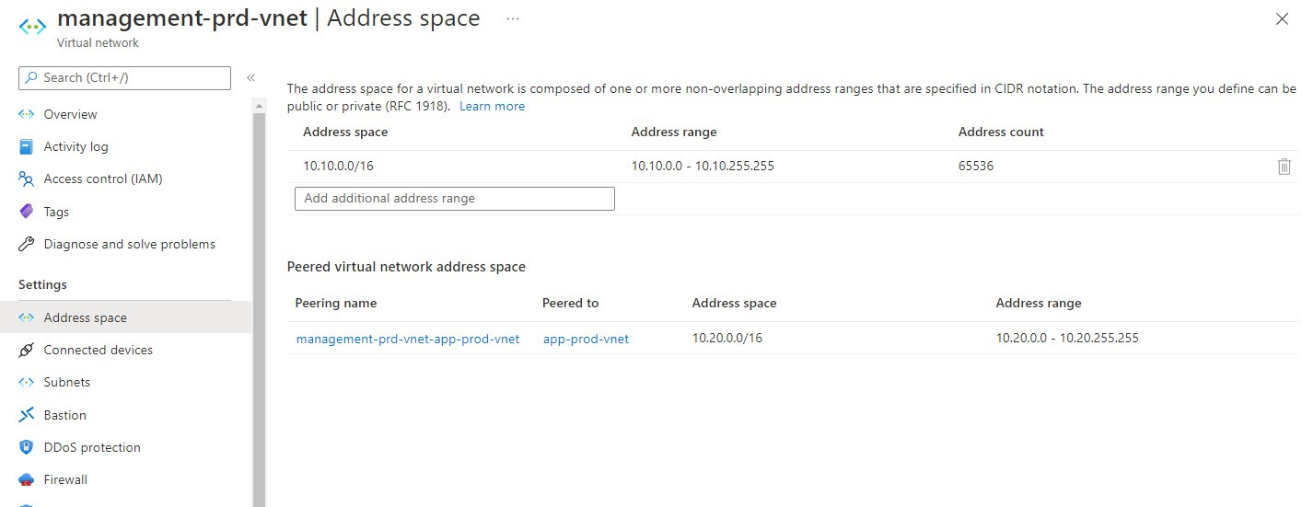
TOPIC 3:
ADMIN
SERVER
MODULE

Slide 15
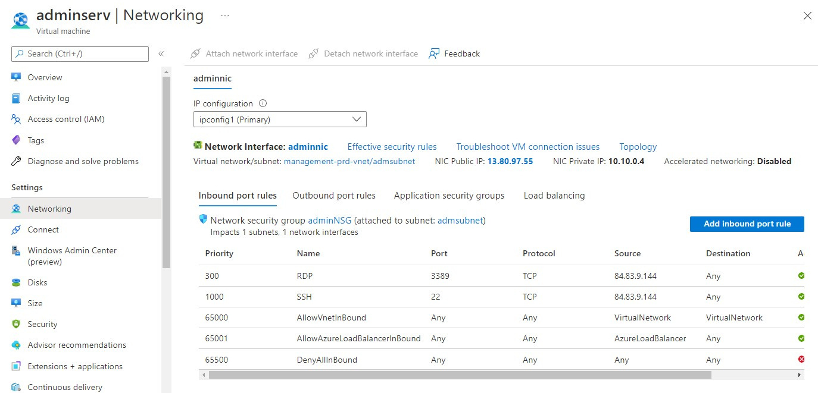
TOPIC 3:
ADMIN
SERVER
MODULE

Slide 16
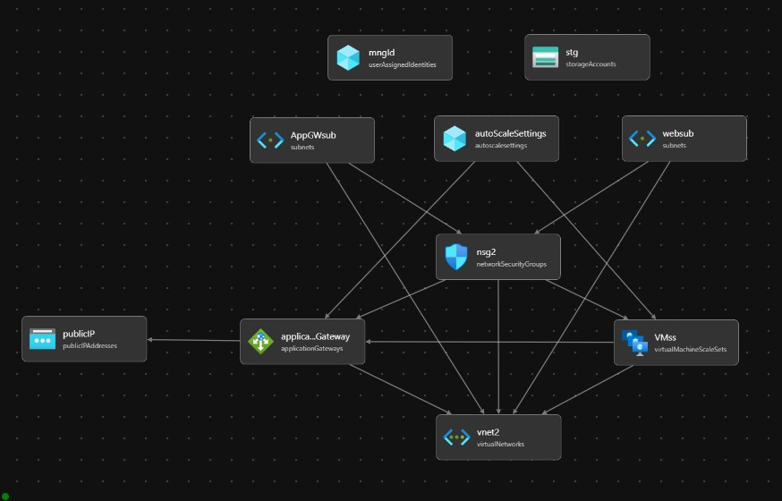
TOPIC 3:
WEB
SERVER
MODULE

Slide 17
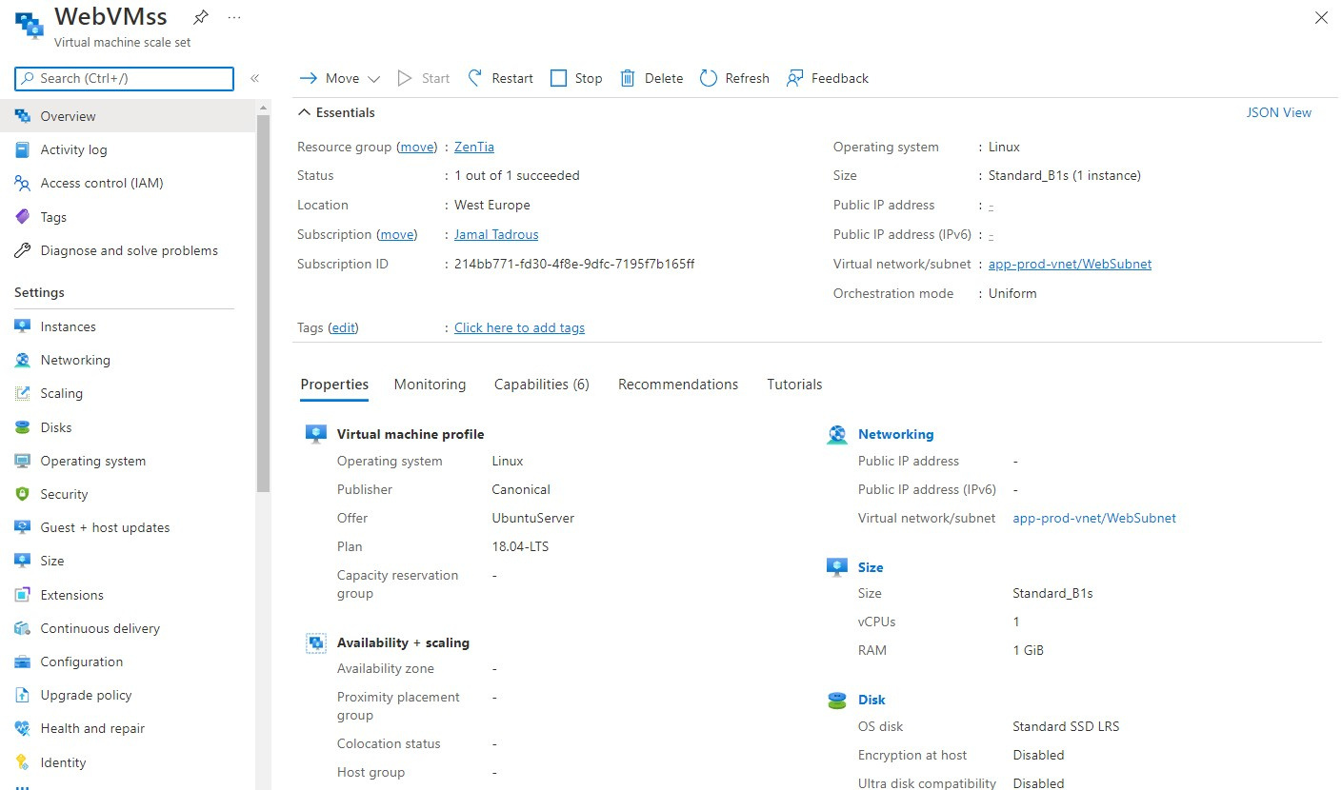
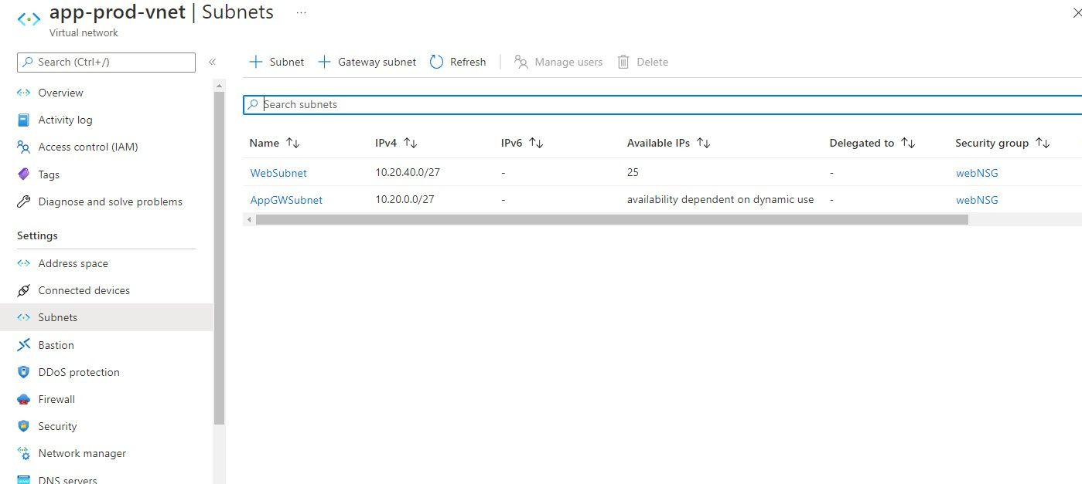
TOPIC 3:
WEB
SERVER
MODULE

Slide 18
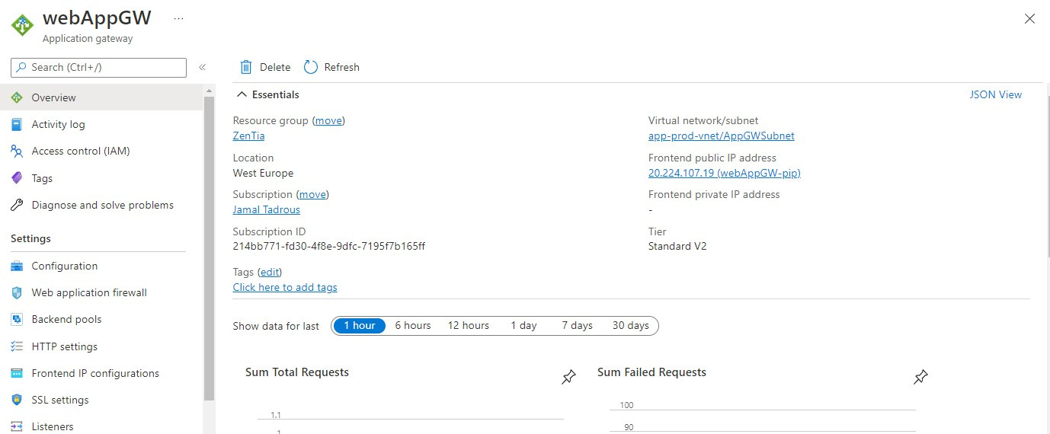
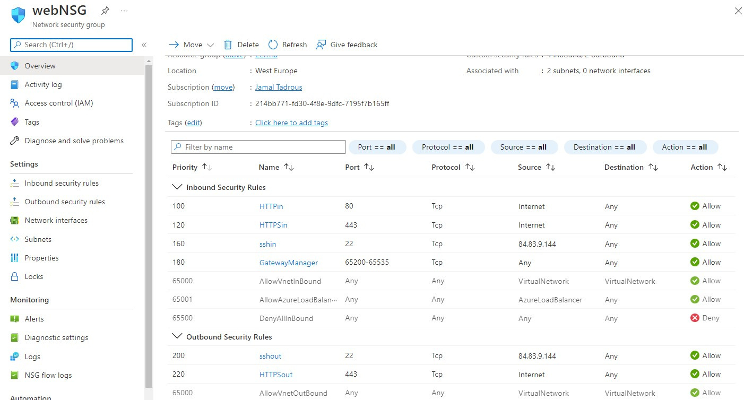
TOPIC 3:
WEB
SERVER
MODULE

Slide 19
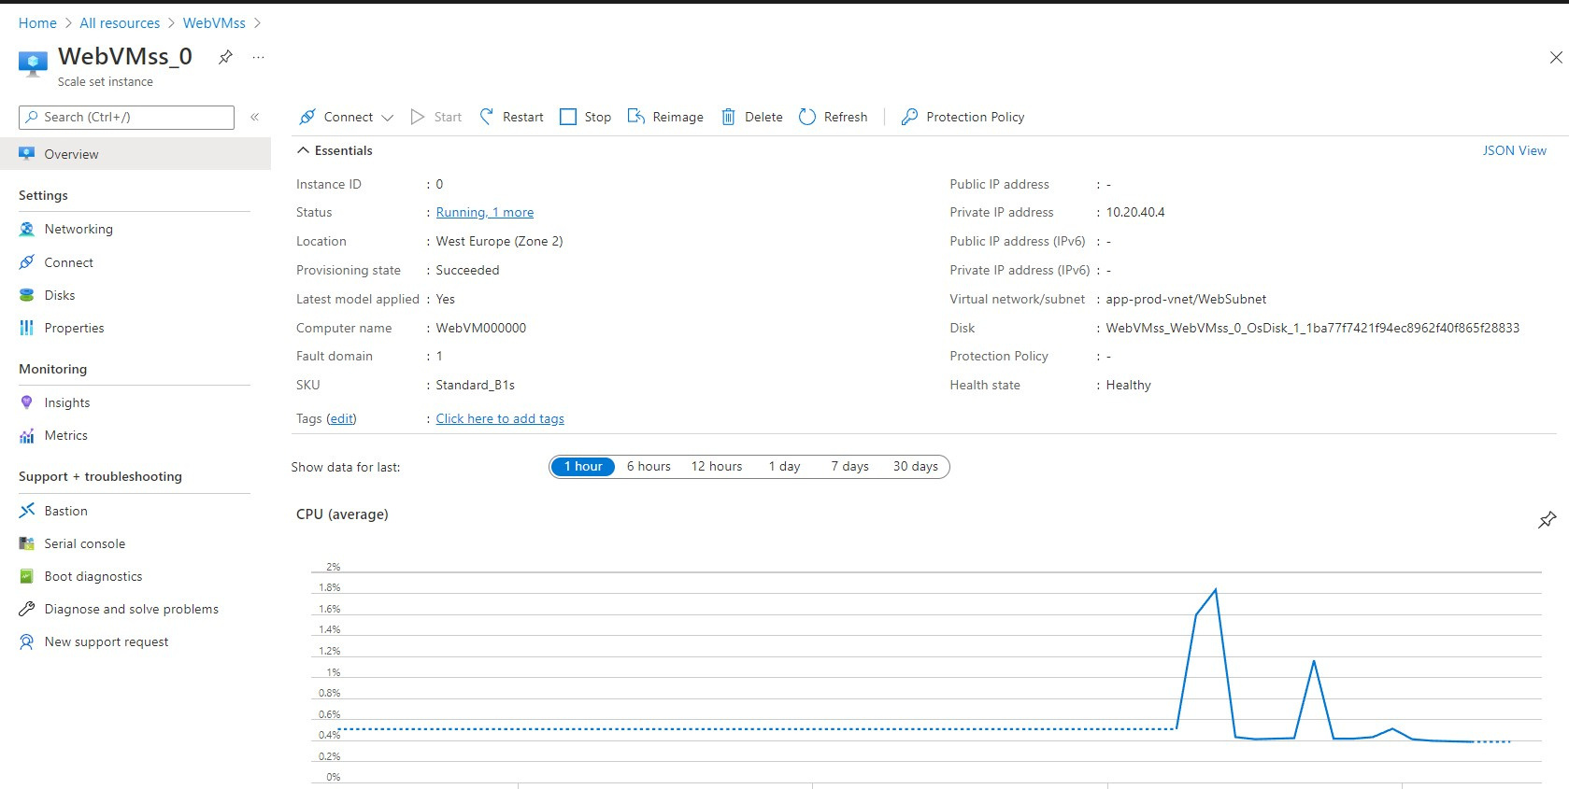
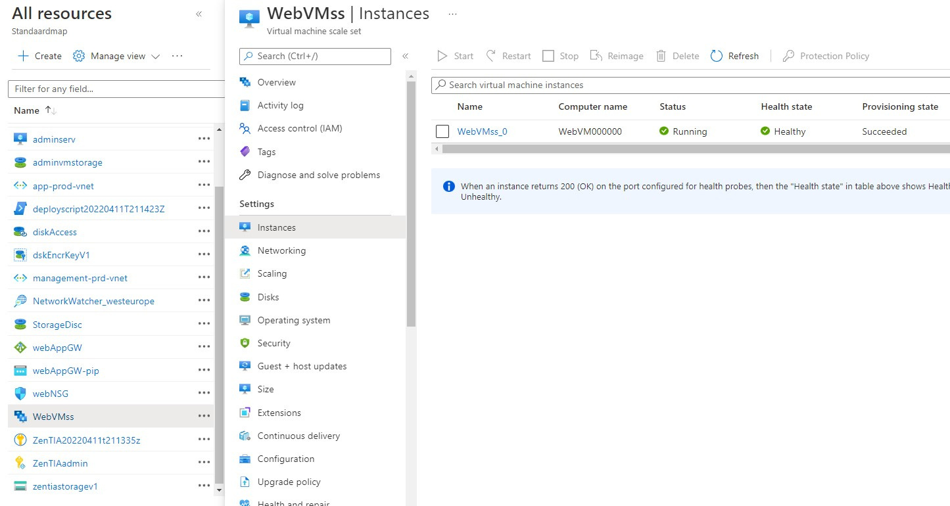
TOPIC 3:
WEB
SERVER
MODULE

Slide 20
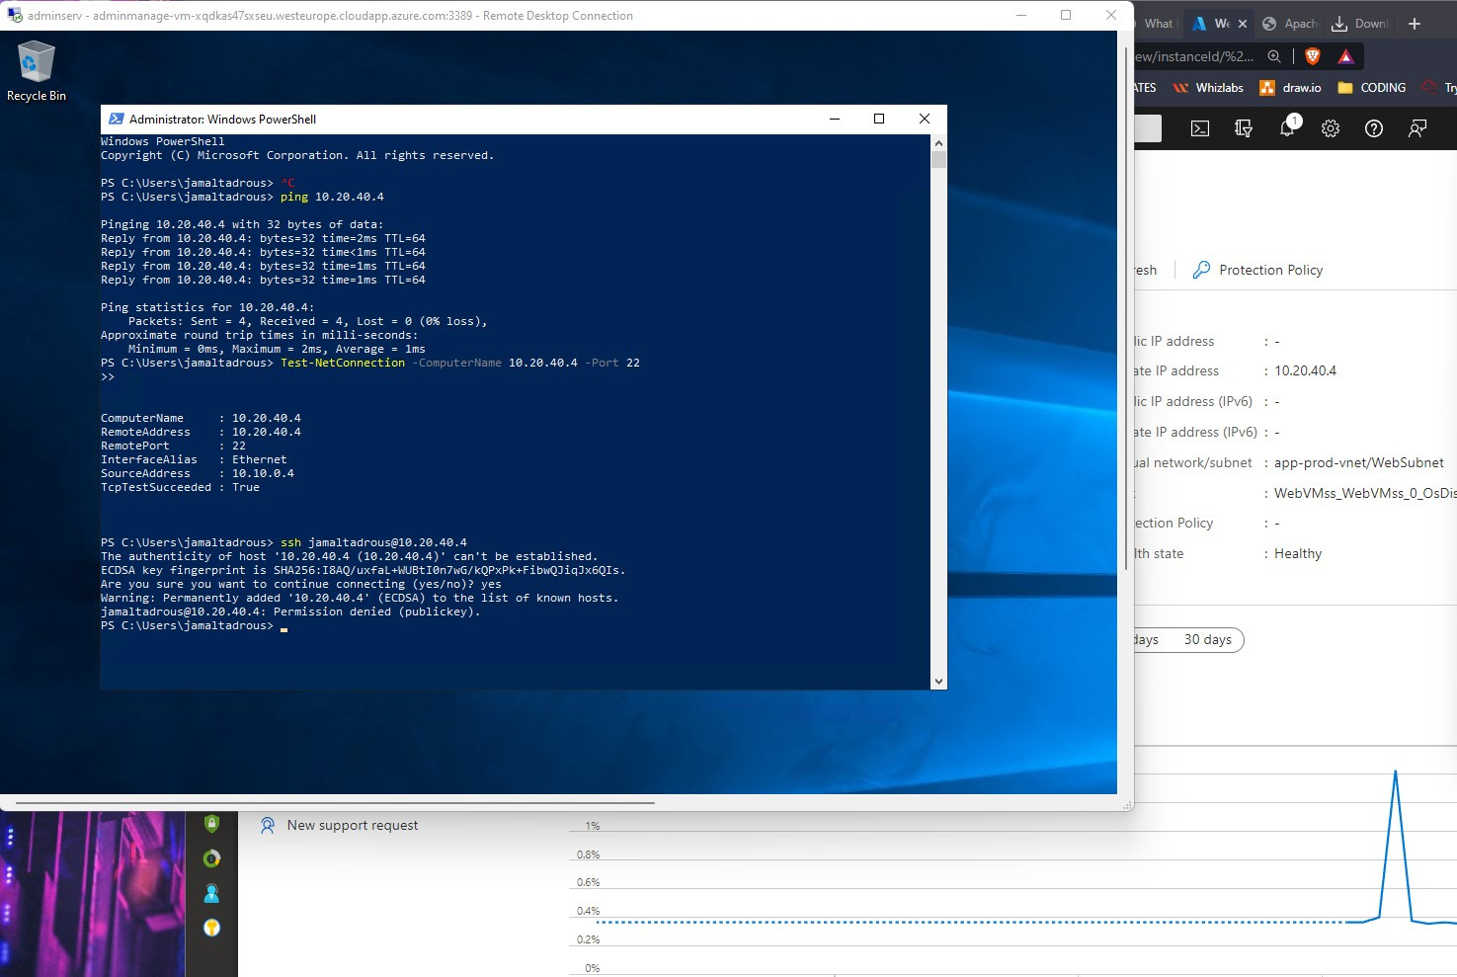
TOPIC 3:
ADMIN
peering
WEB

Slide 21
TOPIC 3:
LET ME SEE YOUR CODE !
DEMO TIME
LETS SWITCH OVER TO VSCODE!

Slide 22
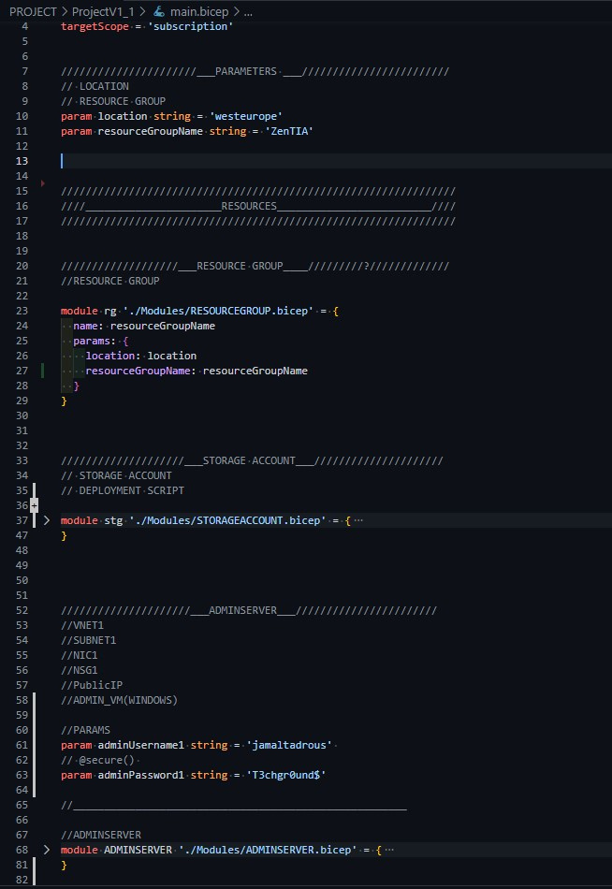
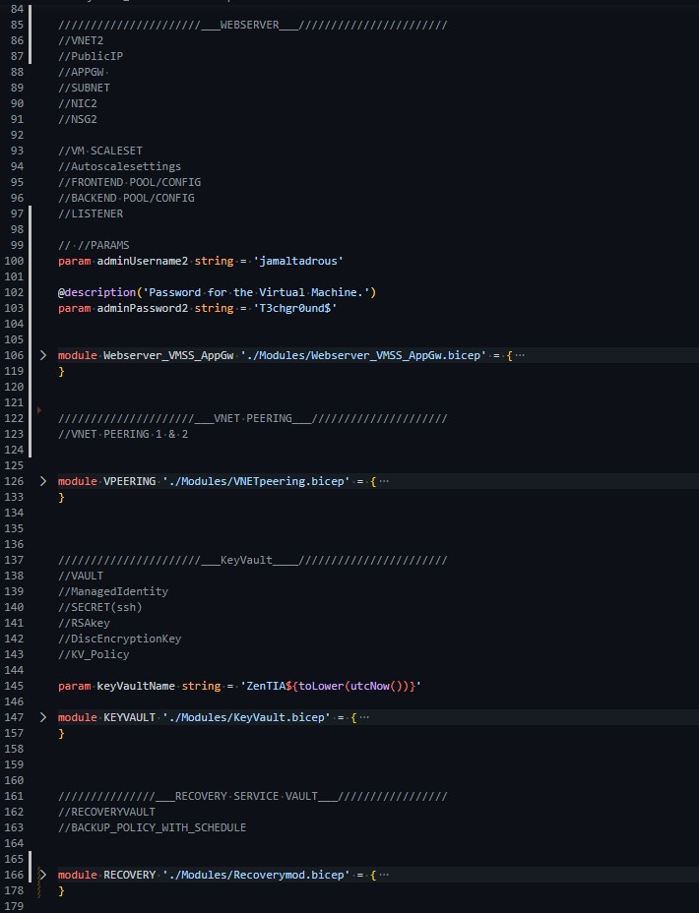
TOPIC 3:
CODE SNIPPITS
/MAIN.BICEP
"MODULES"
RESOURCEGROUP
STORAGE ACCOUNT
ADMINSERVER
WEBSERVER
PEERING
KEYVAULT
RECOVERY SERVICE VAULT

Slide 23
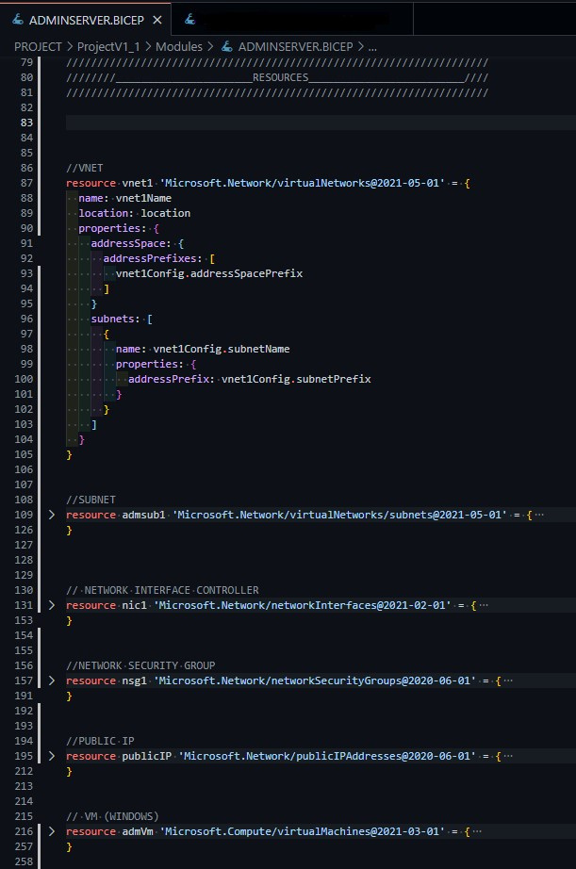
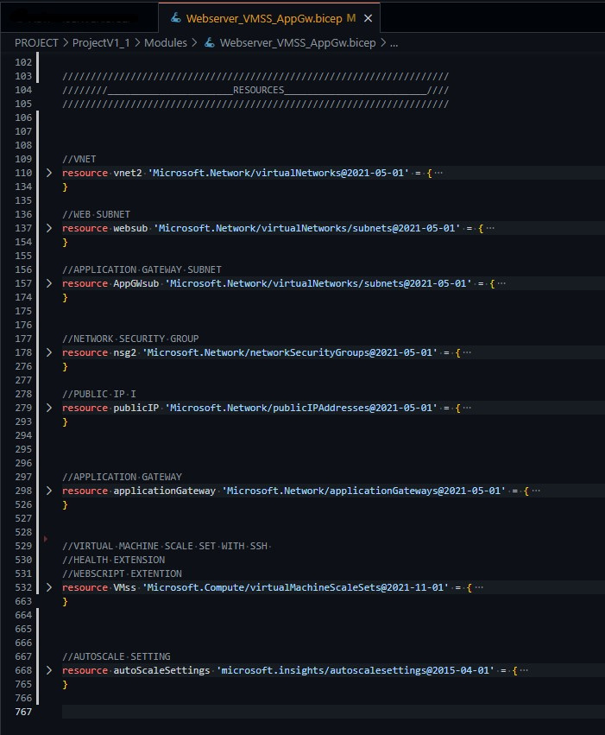
TOPIC 3:
CODE SNIPPIT
PIC.# 1
/ADMINSERVER.BICEP
"MODULE"
CODE SNIPPIT
PIC.# 2
/WEBSERVER.BICEP
"MODULE"

Slide 24



TOPIC 4:
Coding with Bicep.
Using Computational Thinking
to solve problems and fulfill the assignment.
Building Infrastructure.
Creating logical placements for resources,
by the use of module templates.
Learnings
& Conclusion

Slide 25
THANK YOU!
Any Questions?

